Slide 1


Network Life Cycle Analysis for Bridge Management
Rebecca Curtis, P.E.
Michigan Department of Transportation
Bridge Management Engineer
2015 Transportation Asset Management Expert Task Group Webinar Series

Slide 2
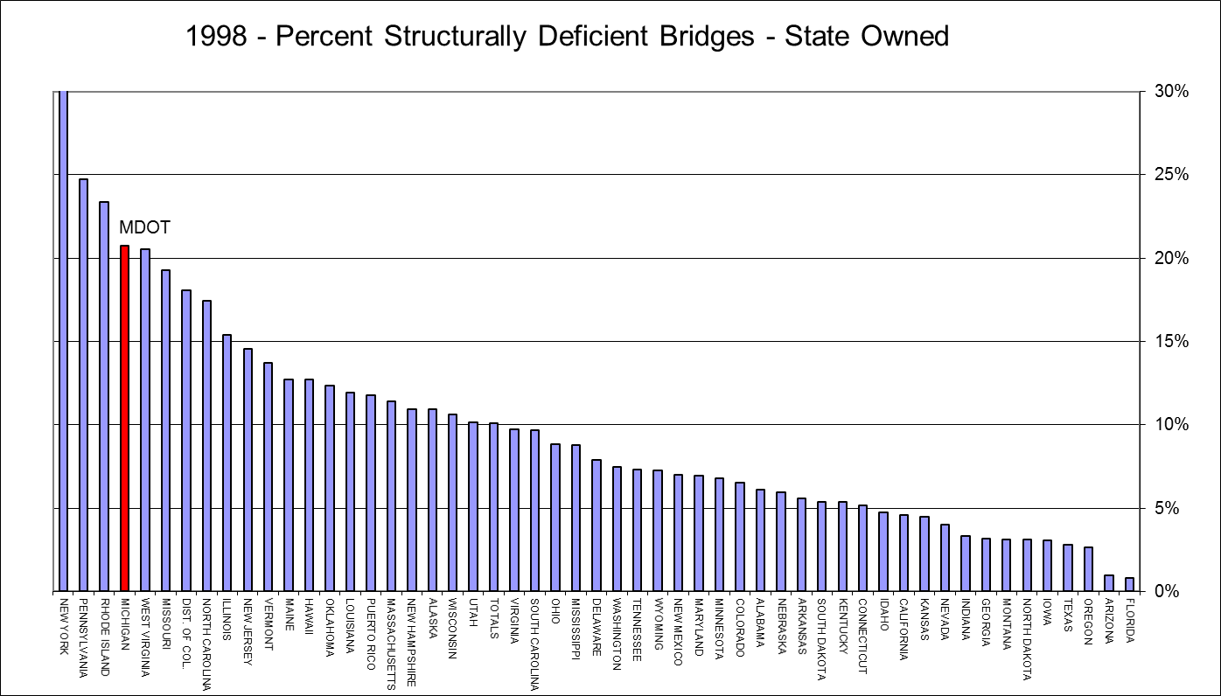
Where did we start?

Slide 3
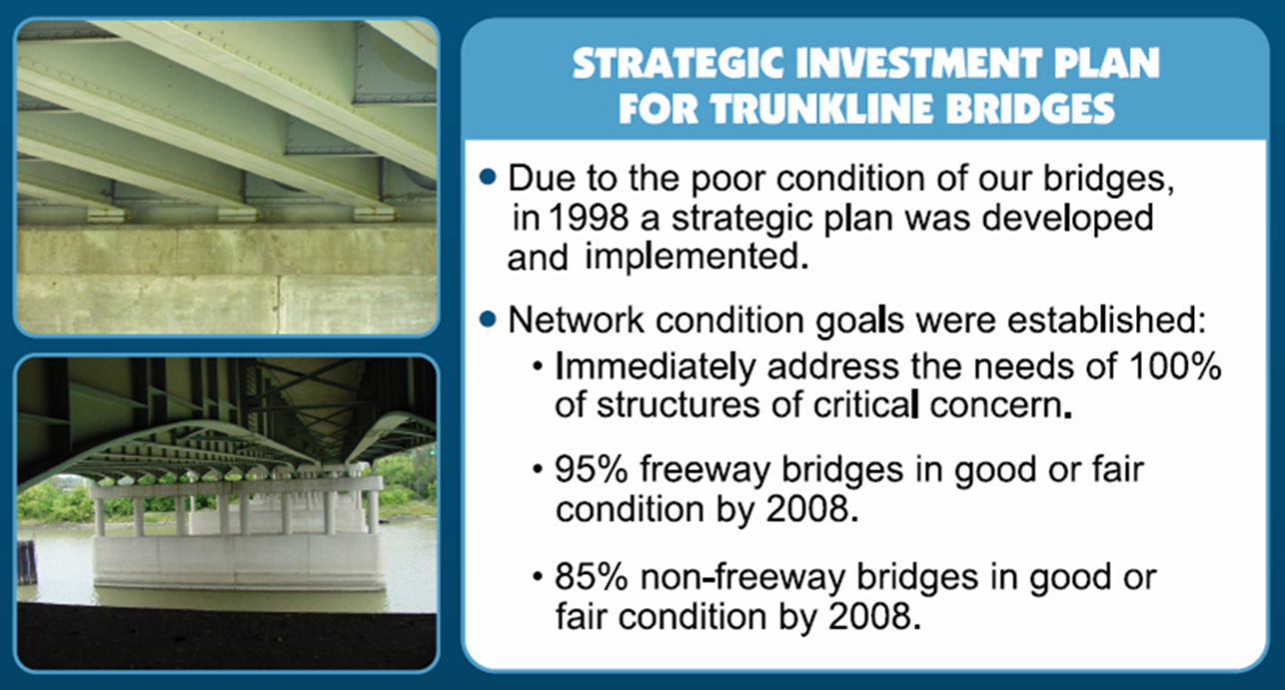
Performance Measures

Slide 4
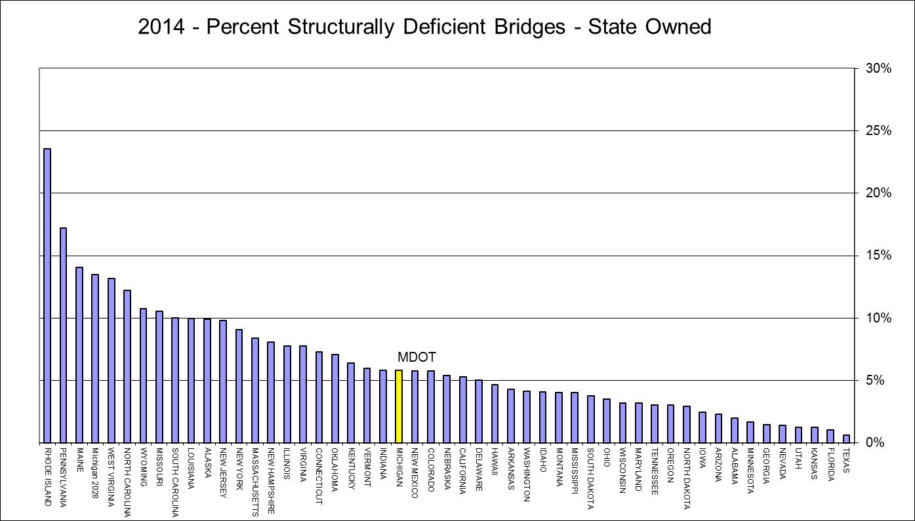
Where are we now?

Slide 5
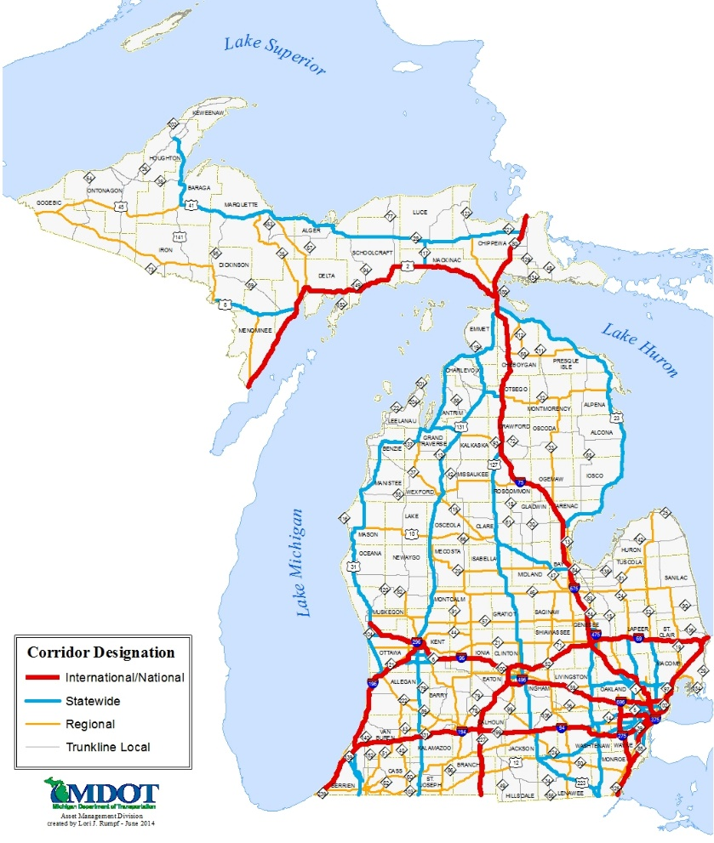
Inventory
Michigan has 10,991 bridges
  State
    4,450 bridges
    94.2% good or fair
  Local Agency
    6,541 bridges
    85.3% good or fair

Slide 6
Network vs. Project Level Analysis
Network Level
  NBI Minimum Condition Ratings
  BCFS for forecasting (spreadsheet)
  Manage populations of bridges
  Provides information for executives, Legislature and State Transportation Commission
Project Level
  National Bridge Elements
  Pontis/AASHTOWareTM Bridge Management Software
  Prioritize between bridge projects
  Manage bridge elements
  Provides information for bridge engineers and practitioners

Slide 7

NBI Condition Ratings

Slide 8
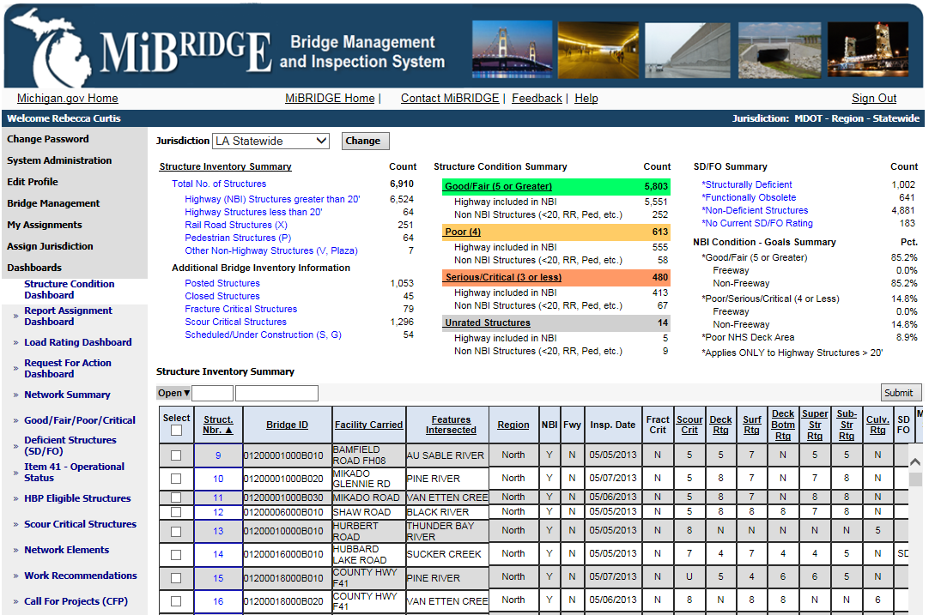
NBI Condition Ratings

Slide 9
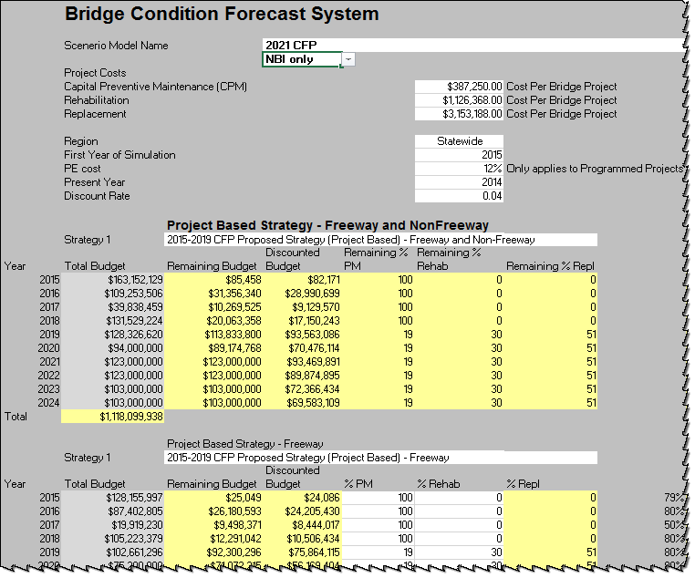
BCFS

Slide 10
BCFS
Inputs:
  NBI conditions
  Budgets
  Strategies – “Mix of Fixes”
    % of budget dedicated to each main work category
  Project costs (by main work category)
  Preservation path
    Anticipated benefits of each main work category
  Can incorporate programmed projects

Slide 11
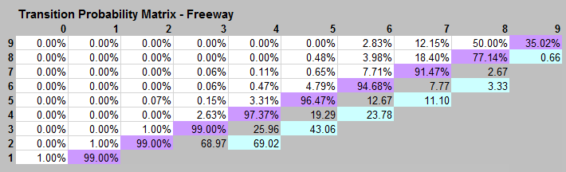
BCFS Results
Transition Probabilities

Slide 12
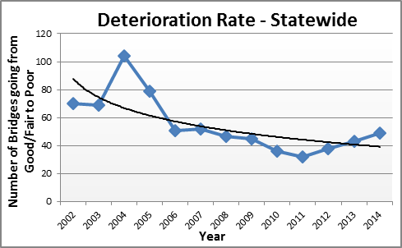
BCFS Results
Track Deterioration Rates

Slide 13
BCFS Results
Forecasted Bridge Conditions

Slide 14
Value of Network Modelling
What is the value of Bridge Preservation? What is the ideal mix of fixes?

Slide 15
Value of Network Modelling
What is the impact of revised budgets? What is the funding need to meet goals?

Slide 16
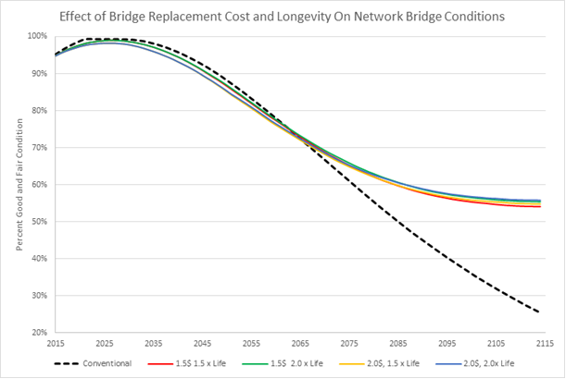
Value of Network Modelling
What is the value of innovative materials?

Slide 17
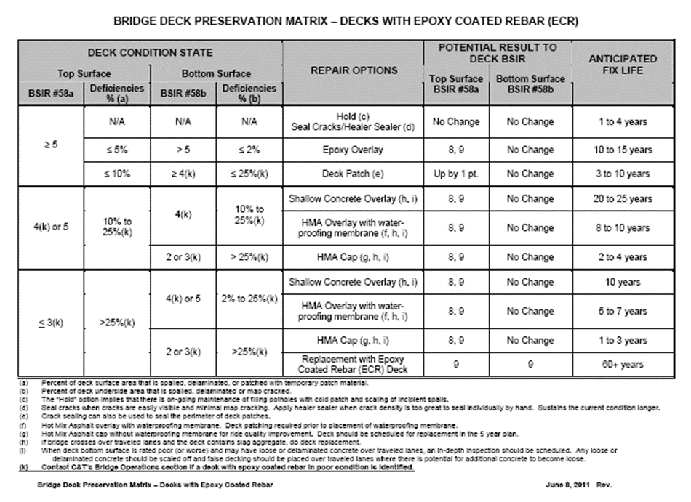
Value of Network Modelling
Develop preservation guidelines

Slide 18
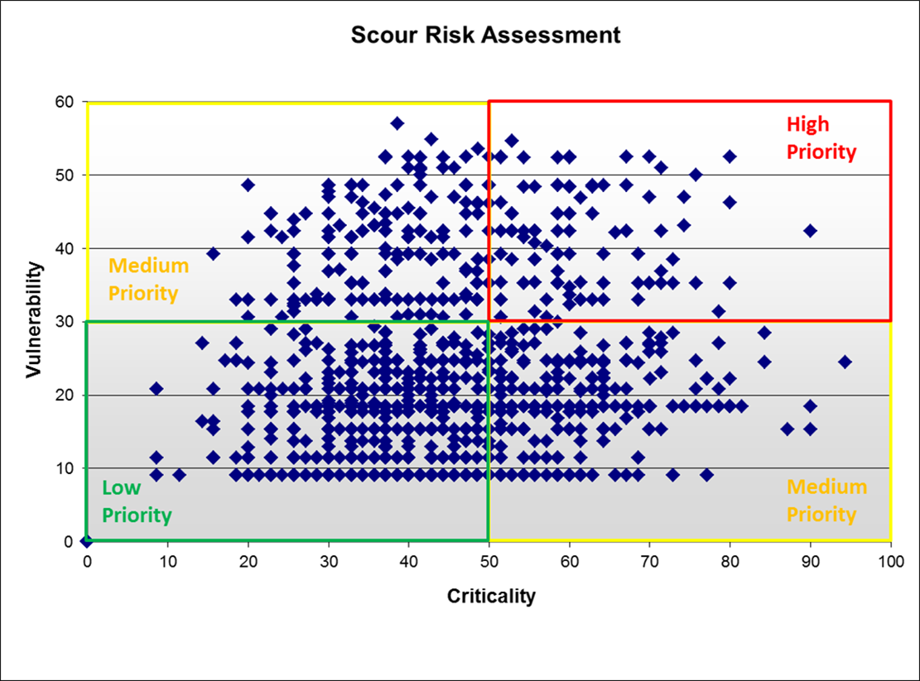
Future Network Modeling at MDOT
Scour Vulnerability Factors
Factor | Relative Weight
Scour (Item 113) | 8.0
# of Sub Units | 3.0
Footing Type | 2.5
Skew Angle | 5.0
Channel Protection | 5.0
Soil Type | 2.5
Scour Mitigation | 2.0
Presence of Scour | 6.0
Total Weight | 34.0
Scour Criticality Factors
Factor | Relative Weight
Highway Classification | 1.0
Traffic Volume | 2.0
Detour Length | 3.0
Cost of Replacement | 3.0
Economic Impact | 5.0
Total Weight | 14.0

Slide 19
Questions?
Rebecca Curtis, P.E.
Michigan Department of Transportation
Bridge Management Engineer
2015 Transportation Asset Management Expert Task Group Webinar Series

