Slide 1
Assessment of State DOT
National Safety Performance Measures
CY2018 – CY2020* Data
Matthew H. Hardy, Ph.D.
Program Director for Planning and Performance Management
November 2022

Slide 2
Performance Management Journey

Slide 3
Performance Management Paradigm
Establishing Targets
  Aggressive versus Achievable Targets
  Maximizing Performance versus Playing the Game
Communication
  Telling the Story
  Creating transparency regardless of the results
Balance
  Federal—State—Local Measures
  Not “versus” but “and”
Accountability
  Data-Driven Decisions
Notes:
The State Safety Performance Management and Targets Paradigm……
FHWA shares the vision that zero fatalities on our Nation's roadways is the only acceptable goal. FHWA also recognizes that reaching zero fatalities will require time and significant effort by everyone. The State's annual safety performance targets represent an important step in helping States work toward the ultimate goal of eliminating traffic deaths and serious injuries. The safety performance targets are considered interim performance levels that make progress toward the long-term goal of zero fatalities.
The safety performance targets are provided in the State HSIP Report and based on a 5-year rolling average. FHWA does not prescribe a methodology for States to set their annual safety performance targets. States have the flexibility to use the methodology they deem most appropriate. The FHWA encourages States to review data sets and trends and consider factors that may affect targets. The safety performance targets should be data-driven, realistic, and attainable and should align with the performance management framework and legislative intent.
The “performance management paradigm” facing States is ……..

Slide 4
Interesting Questions
How many states made significant progress?
How did states make significant progress?
How far off were the targets from the actual numbers?
What kind of targets did states establish?
  Improving/Declining Performance versus Goal/Objective
Are there other techniques that could be used to determine making significant progress?
What is the correlation between target setting technique and making significant progress?
What was the impact of long-term goals (e.g., Toward Zero Deaths) on target achievement and making significant process?

Slide 5
Safety Analysis

Slide 6
PM1: Safety Performance Measures
Transportation Performance Management (TPM) program
Safety Performance Management (Safety PM)
Safety PM Final Rule - 23 CFR 924; 23 CFR 490 (Subpart A & B)
  Number of fatalities
  Fatalities per 100 million vehicle miles traveled
  Number of serious injuries
  Serious injuries per 100 million vehicle miles traveled
  Number of non-motorized fatalities and non-motorized serious injuries
Notes:
Safety Performance Management (Safety PM) is part of the overall Transportation Performance Management (TPM) program, which FHWA defines as a strategic approach that uses system information to make investment and policy decision to achieve national performance goals. The Safety PM Final Rule supports the Highway Safety Improvement Program (HSIP), as it establishes safety performance measure requirements for the purpose of carrying out the HSIP and to assess fatalities and serious injuries on all public roads.
The Safety PM Final Rule establishes five performance measures as the five-year rolling averages to include: ◾Number of fatalities (The total number of persons suffering fatal injuries in a motor vehicle crash during a calendar year), Rate of fatalities per 100 million vehicle miles traveled (VMT) (The ratio of total number of fatalities to the number of vehicle miles traveled (VMT expressed in 100 Million VMT) in a calendar year), Number of serious injuries (The total number of persons suffering at least one serious injury in a motor vehicle crash during a calendar year), Rate of serious injuries per 100 million VMT (The ratio of total number of serious injuries to the number of VMT (VMT expressed in 100 Million VMT) in a calendar year), and Number of non-motorized fatalities and number of non-motorized serious injuries combined (The combined total number of non-motorized fatalities and non-motorized serious injuries involving a motor vehicle during a calendar year).
The Safety PM Final Rule also establishes the process for DOTs and MPOs to establish and report their safety targets, and the process that FHWA will use to assess whether State DOTs have met or made significant progress toward meeting their safety targets. The Safety PM Final Rule also establishes a common national definition for serious injuries. Below are helpful resources to support the implementation of the Safety PM Final Rule.

Slide 7
FHWA Significant Progress Assessment
Did a state meet their targets?
  Actual Performance is better than the Target; or
  Actual Performance is better than the Baseline
Did a state meet their targets for 4 outr of the 5 performance measures?
States that Made Significant Progress | Yes | No
2018 | 27 | 25
2019* | 22 | 29
2020 | 21 | 31
Notes:
* Missing Puerto Rico
State Target Achievement
On April 24, 2020 the FHWA determined whether each State has met or made significant progress toward its safety performance targets and reported the findings to States and the public. A State is considered to have met or made significant progress when at least four out of the five safety performance targets are met or the actual outcome for the safety performance target is better than baseline performance.
CPBM analyzed all the results and found that: 27 State DOTs Made Significant Progress and 25 State DOTs Did Not Make Significant Progress

Slide 8
How did state DOTs make significant progress?
Count of States | 2018 | 2019 | 2020
Made Significant Progress | 27 | 22 | 21
Meet or Exceed Targets for 4 of the 5 Indicates how many states met or exceeded their targets without using the baseline assessment. | 16 | 14 | 14
Baseline Assessment as an Alternative to Assess Significant Progress Indicates how many states did not meet or exceed the established target but used the baseline assessment to determine significant progress. | 36 | 26 | 26
Baseline Assessment Enabled to Make Significant Progress Indicates the number of states that needed the baseline assessment to say they made significant progress. | 11 | 8 | 7
Conclusions
  The number of states making significant progress declined.
  Less states needed the Baseline Assessment to ensure they made significant progress
  Baseline Assessment is an important backstop to enable State DOTs to establish more aggressive targets.

Slide 9
If a State did not make significant progress
Use obligation authority equal to the HSIP apportionment for the year prior to the year for which the targets were not met or significant progress was not made, only for HSIP projects; and
Submit an annual HSIP Implementation Plan that describes actions the State will take to meet or make significant progress toward meeting its subsequent targets. Under 23 U.S.C. 148(i), the HSIP Implementation Plan must:
  Identify roadway features that constitute a hazard to road users;
  Identify highway safety improvement projects on the basis of crash experience, crash potential, or other data supported means;
  Describe how HSIP funds will be allocated, including projects, activities, and strategies to be implemented;
  Describe how the proposed projects, activities, and strategies funded under the State HSIP will allow the State to make progress toward achieving the safety performance targets; and
  Describe the actions the State will undertake to achieve the performance targets.

Slide 10
Types of Targets
Increasing: Safety Performance is DECLINING
Decreasing: Safety Performance is IMPROVING
Count of States | 2018 |  | 2019 |  | 2020
 | Increasing | Decreasing | Increasing | Decreasing | Increasing | Decreasing
Fatality | 25 | 27 | 25 | 27 | 28 | 23
Fatality Rate | 19 | 33 | 21 | 31 | 19 | 32
Serious Injury | 17 | 35 | 17 | 35 | 15 | 36
Serious Injury Rate | 16 | 36 | 12 | 40 | 11 | 40
Non-Motorized | 26 | 26 | 21 | 31 | 24 | 27

Slide 11
State Target Achievement
[2018, 2020: 260 targets (52x5)] [2019: 255 (52x5) Puerto Rico Excluded]
Count of States (Percent) | Met Targets |  |  | Met Targets/Baseline
 | 2018 | 2019 | 2020 | 2018 | 2019 | 2020
Fatality | 22 (42%) | 22 (43%) | 21 (40%) | 29 (56%) | 26 (51%) | 27 (52%)
Fatality Rate | 23 (44%) | 23 (45%) | 13 (25%) | 32 (62%) | 31 (61%) | 19 (37%)
Serious Injury | 31 (60%) | 29 (57%) | 28 (54%) | 43 (83%) | 40 (78%) | 35 (67%)
Serious Injury Rate | 33 (63%) | 29 (57%) | 22 (42%) | 47 (90%) | 41 (80%) | 37 (71%)
Non-Motorized | 23 (44%) | 19 (37%) | 23 (44%) | 28 (54%) | 24 (47%) | 31 (60%)

Slide 12
Accuracy of Targets
Indicates how close to the actual target a state DOT got. This is +/-.
Count of States | 2018 |  |  | 2019 |  |  | 2020
 | 2% | 5% | 10% | 2% | 5% | 10% | 2% | 5% | 10%
Fatality | 20 | 34 | 43 | 12 | 30 | 43 | 16 | 33 | 45
Fatality Rate | 13 | 29 | 41 | 10 | 32 | 45 | 12 | 28 | 42
Serious Injury | 6 | 24 | 36 | 6 | 23 | 35 | 9 | 24 | 36
Serious Injury Rate | 8 | 21 | 33 | 12 | 23 | 33 | 9 | 25 | 38
Non-Motorized | 11 | 26 | 38 | 5 | 19 | 36 | 6 | 24 | 32

Slide 13
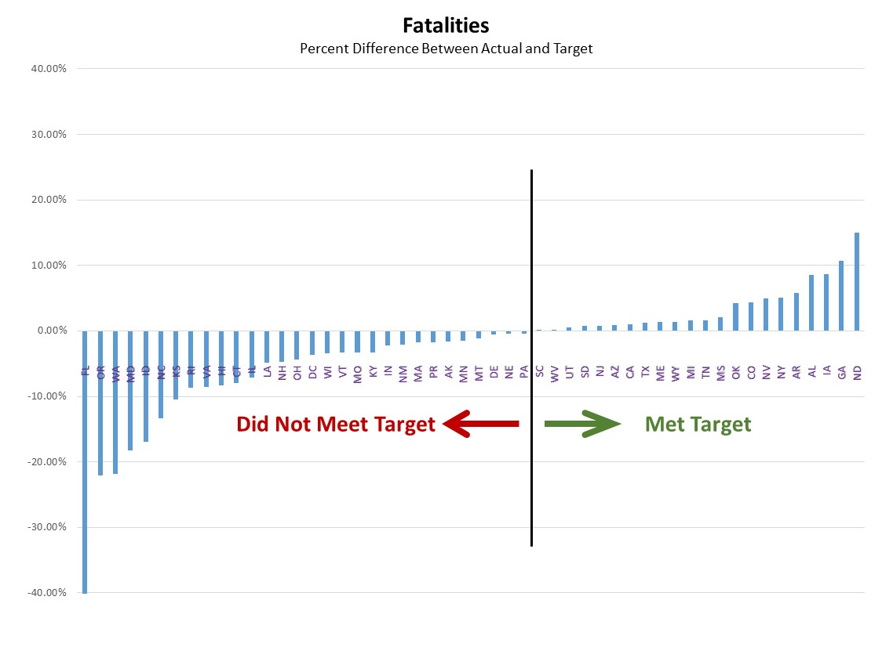
Notes:
These next few charts show the percent difference for each performance measure target and actual result.
The black line indicates the cutoff (0) between a state DOT meeting its target or not.
While the variability between target and actual increases between fatality, serious injury, and non-motorized fatality, the vast majority of states establish a target within 10% of the actual.

Slide 14
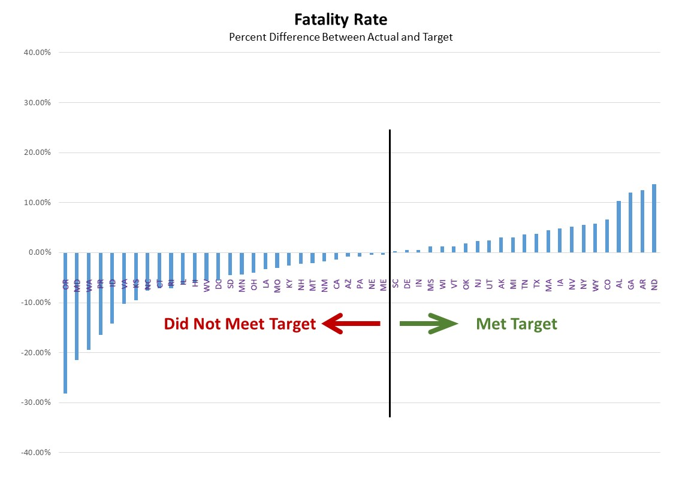

Slide 15
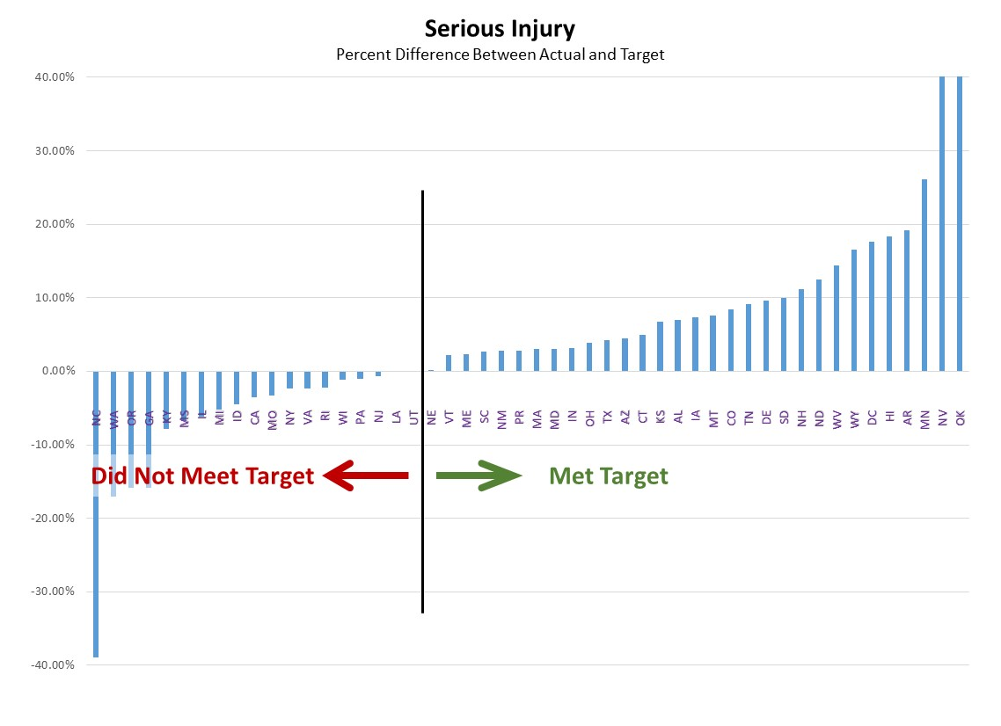

Slide 16
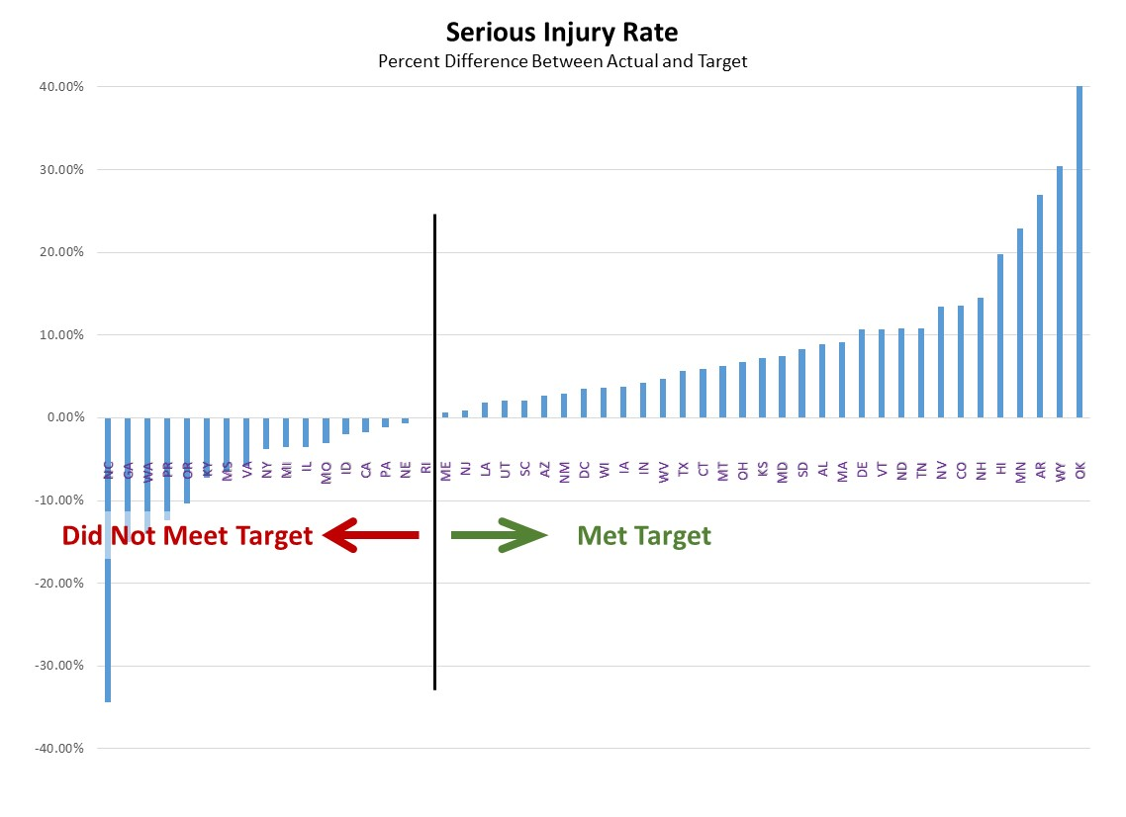

Slide 17
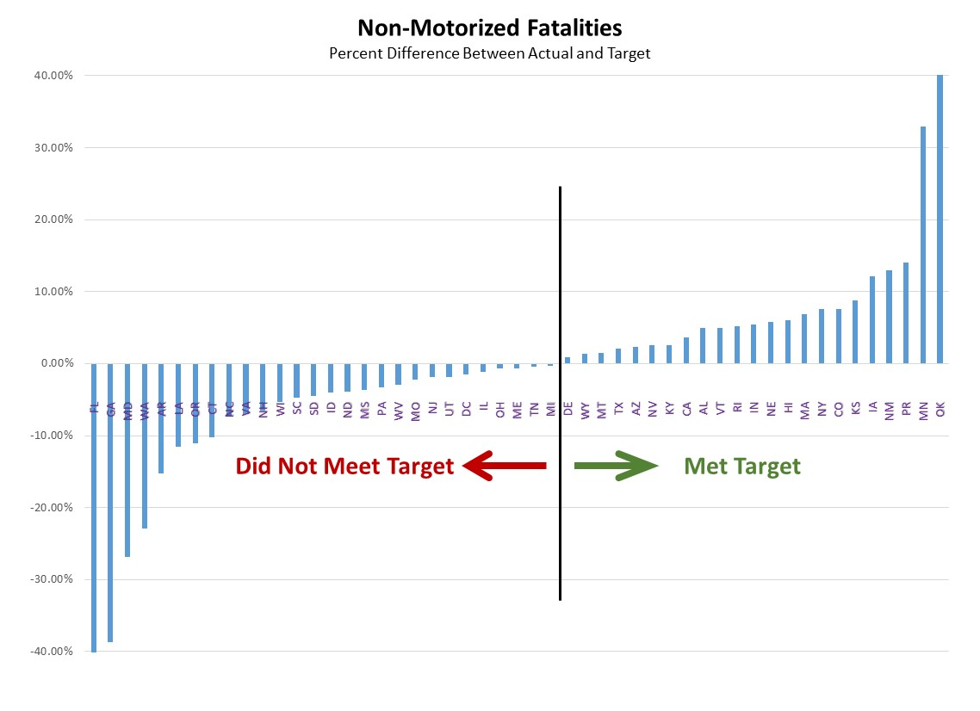

Slide 18
Difference Between Actual and Target
Fatality | 2018 | 2019 | 2020
Count
Overestimate | 3.67% | 4.73% | 4.80%
Underestimate | -6.47% | -6.23% | -6.42%
Rate
Overestimate | 4.62% | 5.40% | 5.52%
Underestimate | -7.01% | -5.81% | -7.01%
Serious Injury | 2018 | 2019 | 2020
Count
Overestimate | 10.15% | 7.35% | 7.00%
Underestimate | -7.10% | -10.51% | -11.67%
Rate
Overestimate | 8.85% | 8.66% | 6.48%
Underestimate | -7.38% | -9.88% | -10.99%
Non-Motorized | 2018 | 2019 | 2020
Count
Overestimate | 6.91% | 4.46% | 8.89%
Underestimate | -7.43% | -8.47% | -10.44%
Conclusions→ Vast majority of the State DOTs set targets that were close to the actual. The difference between meeting a target and not meeting a target was sometimes less than 0.03%

Slide 19
What’s Next?

Slide 20
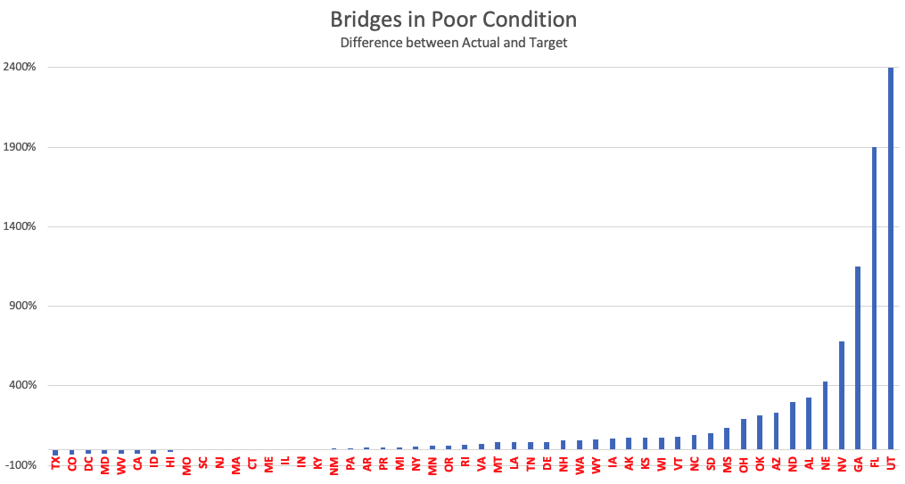
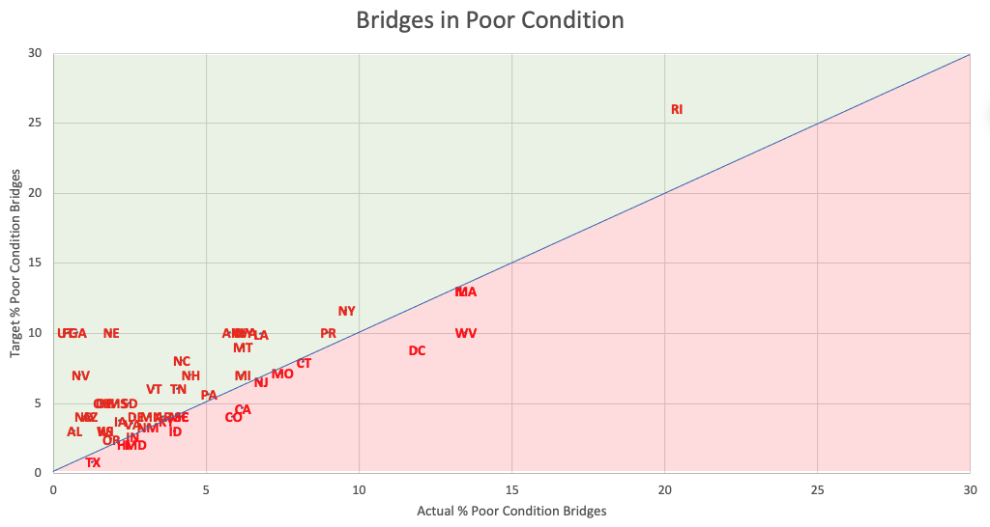
Visualization: Bridge Analysis

Slide 21
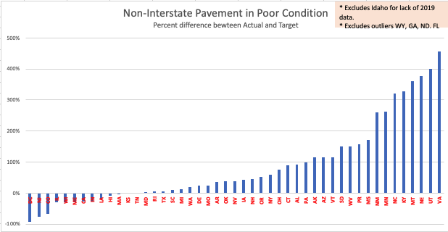
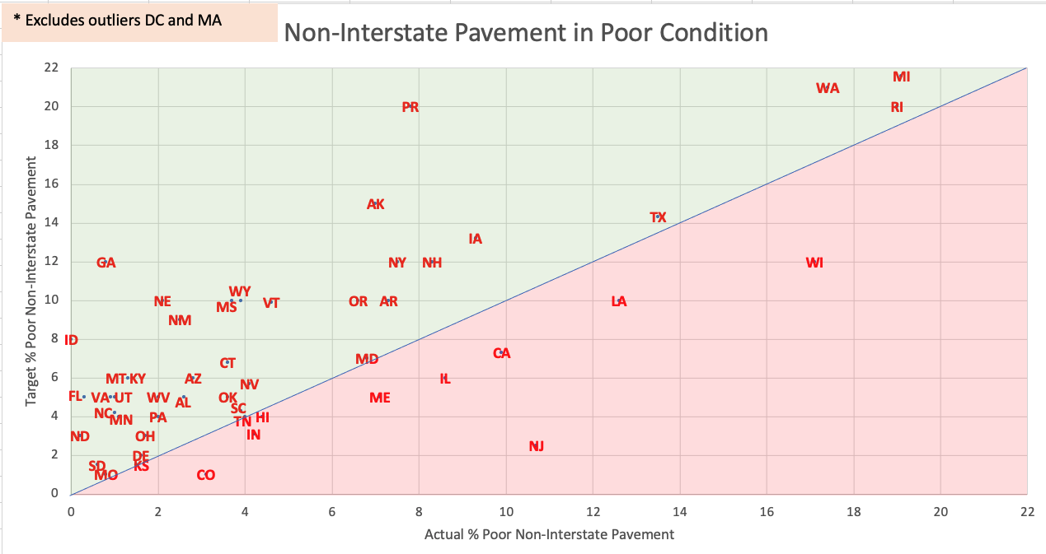
Visualization: Pavement Analysis

Slide 22
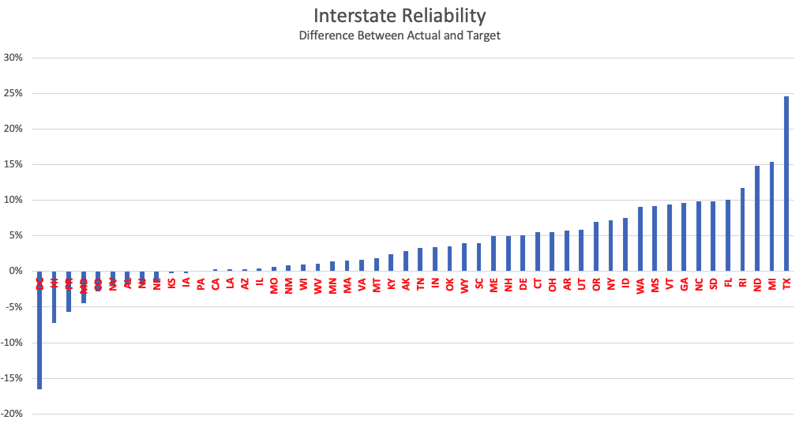
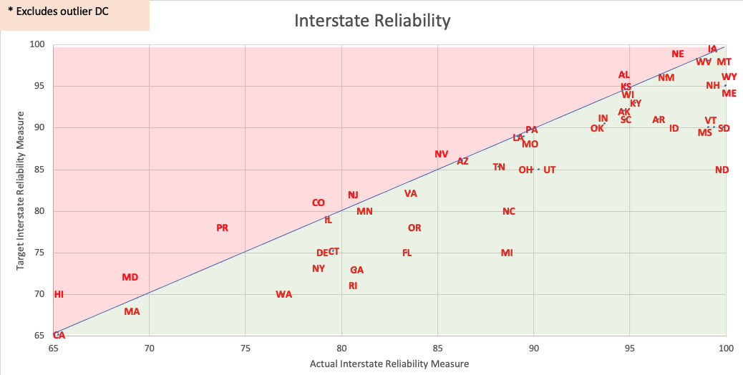
Visualization: Interstate Reliability

Slide 23
State DOT Target Types*
* Note the following concerning the data (preliminary analysis—do not quote):
  Safety data compares 2015-2019 TARGET with 2013-2017 BASELINE
  Pavement, Bridges, TTR and Freight compares State 4-Year TARGET with BASELINE

Slide 24
Thought Questions
What is the purpose of performance management?
  Communications tool to report on progress
  Resource allocation
    What can I get with the funding I have?
    How much funding do I need to achieve the performance you want?
Flow of funding
  Federal, state, and local funding
  Funding spent is not necessarily the entire story
Target setting: Short versus Long Term
  Short Term: Incremental improvements; predict what is possible
  Long Term: Reflect fundamental shifts; indicate where we want to be
Establishing directionality of targets
  Goal: Aspirational in nature (Florida)
  Objective: SMART → Specific, Measureable, Attainable, Realistic, Time-bound
Assessing Progress
  Somewhat arbitrary, more opinion than fact.
  How close did you get? → Not yes/no but proximity to the actual target.
  Absolute versus scale. → Pass/Fail (current) versus Scale (better?)

Slide 25
Analysis and Assessment of the National
Performance Management Data
(NCHRP 08-168)
Goals
  Prepare an authoritative analysis and assessment of the national performance management data
  Provide recommendations on future capacity building activities and possible new performance measures.
Objectives
  Analysis of the national performance management data for the three performance measurement areas.
  Assessment of the performance management data that provides a comprehensive and compelling story on the results of the performance management provisions.
  Identification of future capacity building needs and performance measures.
RFP Coming Soon!

Slide 26
Thank you!
Matthew Hardy, Ph.D.
mhardy@aashto.org
(703) 868-7154

