Slide 1




Transportation Asset Management Webinar Series
Webinar 30
Reflections on 40+ Years of TAM
Sponsored by FHWA and AASHTO
May 20, 2026

Slide 2
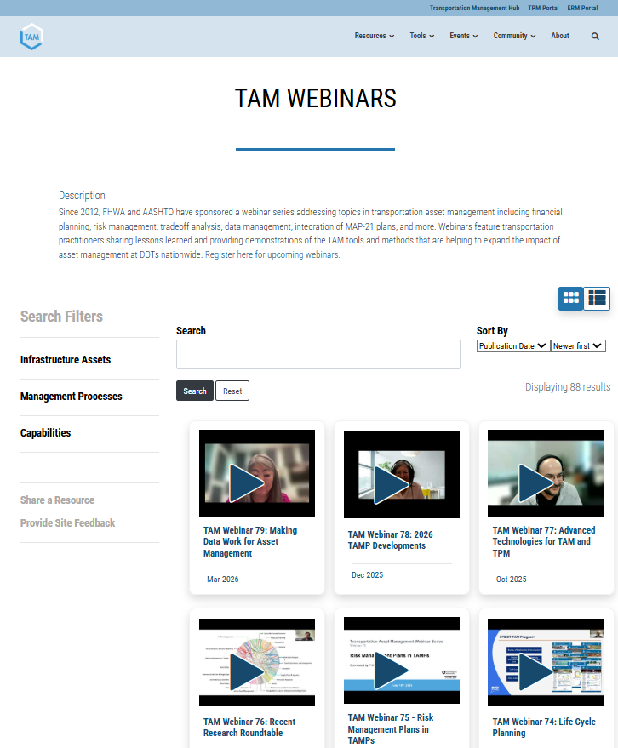
Welcome!
Today is the 80th webinar in our bimonthly series, held on Wednesdays at 2:00 PM ET
Webinars cover a variety of topics with a performance management focus
  You will be able to find the materials from this webinar on the TAM Portal: https://www.tam-portal.com/event-directory/tam-webinars/
We are always welcoming ideas for webinar topics and presentations!
Use the webinar chat to submit questions for today’s presenters and ideas for future webinars

Slide 3
FHWA and AASHTO Collaboration
The FHWA Asset Performance Team and the AASHTO Subcommittee on Asset Management are pleased to cosponsor this webinar series
Sharing knowledge is a critical component of advancing agency practices
  FHWA Transportation Asset Performance: https://www.fhwa.dot.gov/tap/resources_and_publications.cfm
  AASHTO Transportation Management Hub: https://www.transportationmanagement.us/

Slide 4
Webinar Objectives
  Feature practitioners’ reactions to Katie’s speech and an exploration of the core theme of resilience
  Highlight asset management victories and ongoing difficulties at agencies around the country
  Identify next steps, including ways to continue integrating asset management across organizational silos
  And as always, share lessons-learned, ideas, and knowledge!!!
4

Slide 5
Webinar Agenda
2:00 Welcomes, Overview, and Agenda
Anna McLaughlin, AASHTO
Hyun-A Park, Spy Pond Partners
2:10 Asset Management’s Resilience: Will We Survive or Thrive in the Next Decade?
Katie Zimmerman, Applied Pavement Technologies
2:55 Asset Management Practitioners Panel
Jamie Kavelak, Delaware Department of Transportation
Justin Bruner, Pennsylvania Department of Transportation
Matt Versdahl, Washington State Department of Transportation
Mike Rossi, New York State Department of Transportation
Virginia Stubella, New Mexico Department of Transportation
3:28 Q&A Discussion and Wrap Up
Hyun-A Park, Spy Pond Partners
5

Slide 6


Asset Management’s Resilience: Will We Survive or Thrive In The Next Decade?
₁₅ TH
NATIONAL CONFERENCE ON TRANSPORTATION ASSET MANAGEMENT
Katie Zimmerman, P.E.

Slide 7
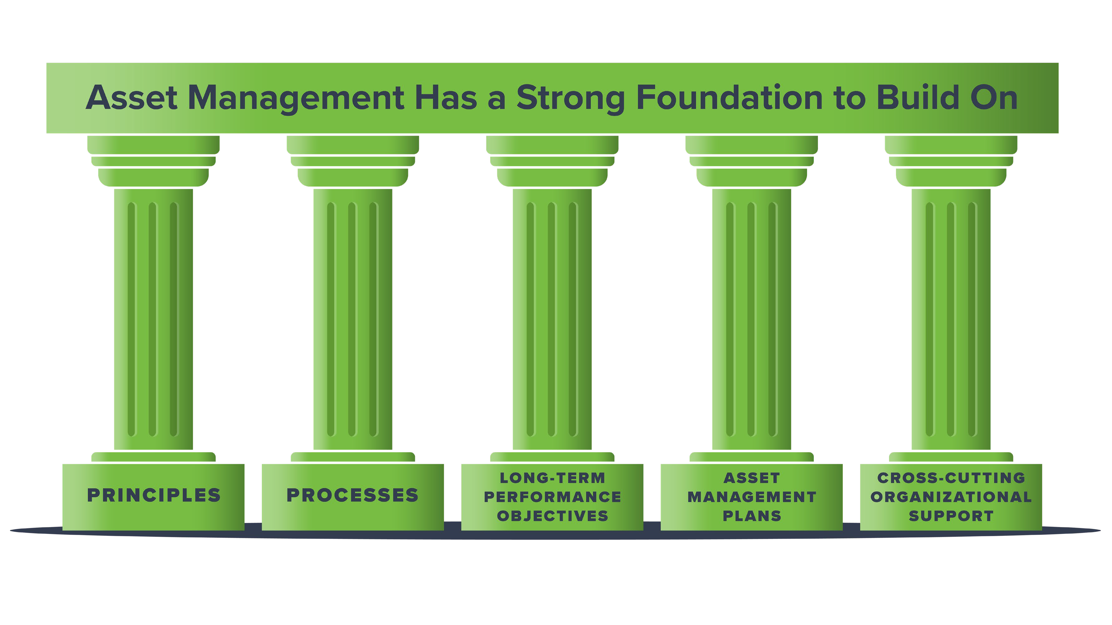

Slide 8



Resilience
The FHWA defines resilience as:
The ability of a transportation system to anticipate, prepare for, and adapt to changing conditions, and to withstand, respond to, and recover rapidly from disruptions

Slide 9

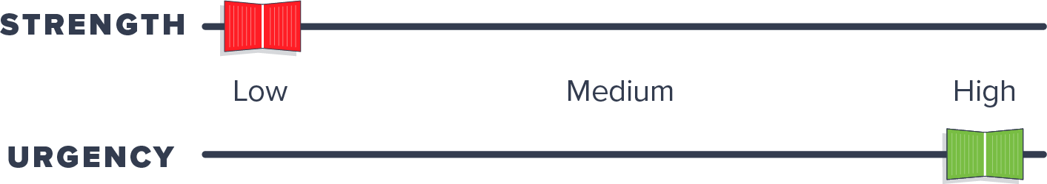
Technological Adaptability
Strengths
  Availability of technology
We aknesses
  Speed of innovation
  Potential conflicts in system compatibility
  Ability to turn data into use ful information
  New issue s, such as cybersecurity threats, data ownership issue s, e tc.

Slide 10

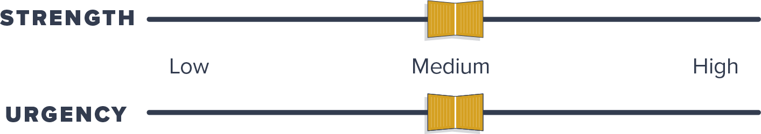
Economic Stability
Strengths
  Incre ased focus on
preservation & life cycle planning
We aknesses
  Inability to quantify a ROI for asset management
  Vulne rability to shifts in agency prioritie s

Slide 11
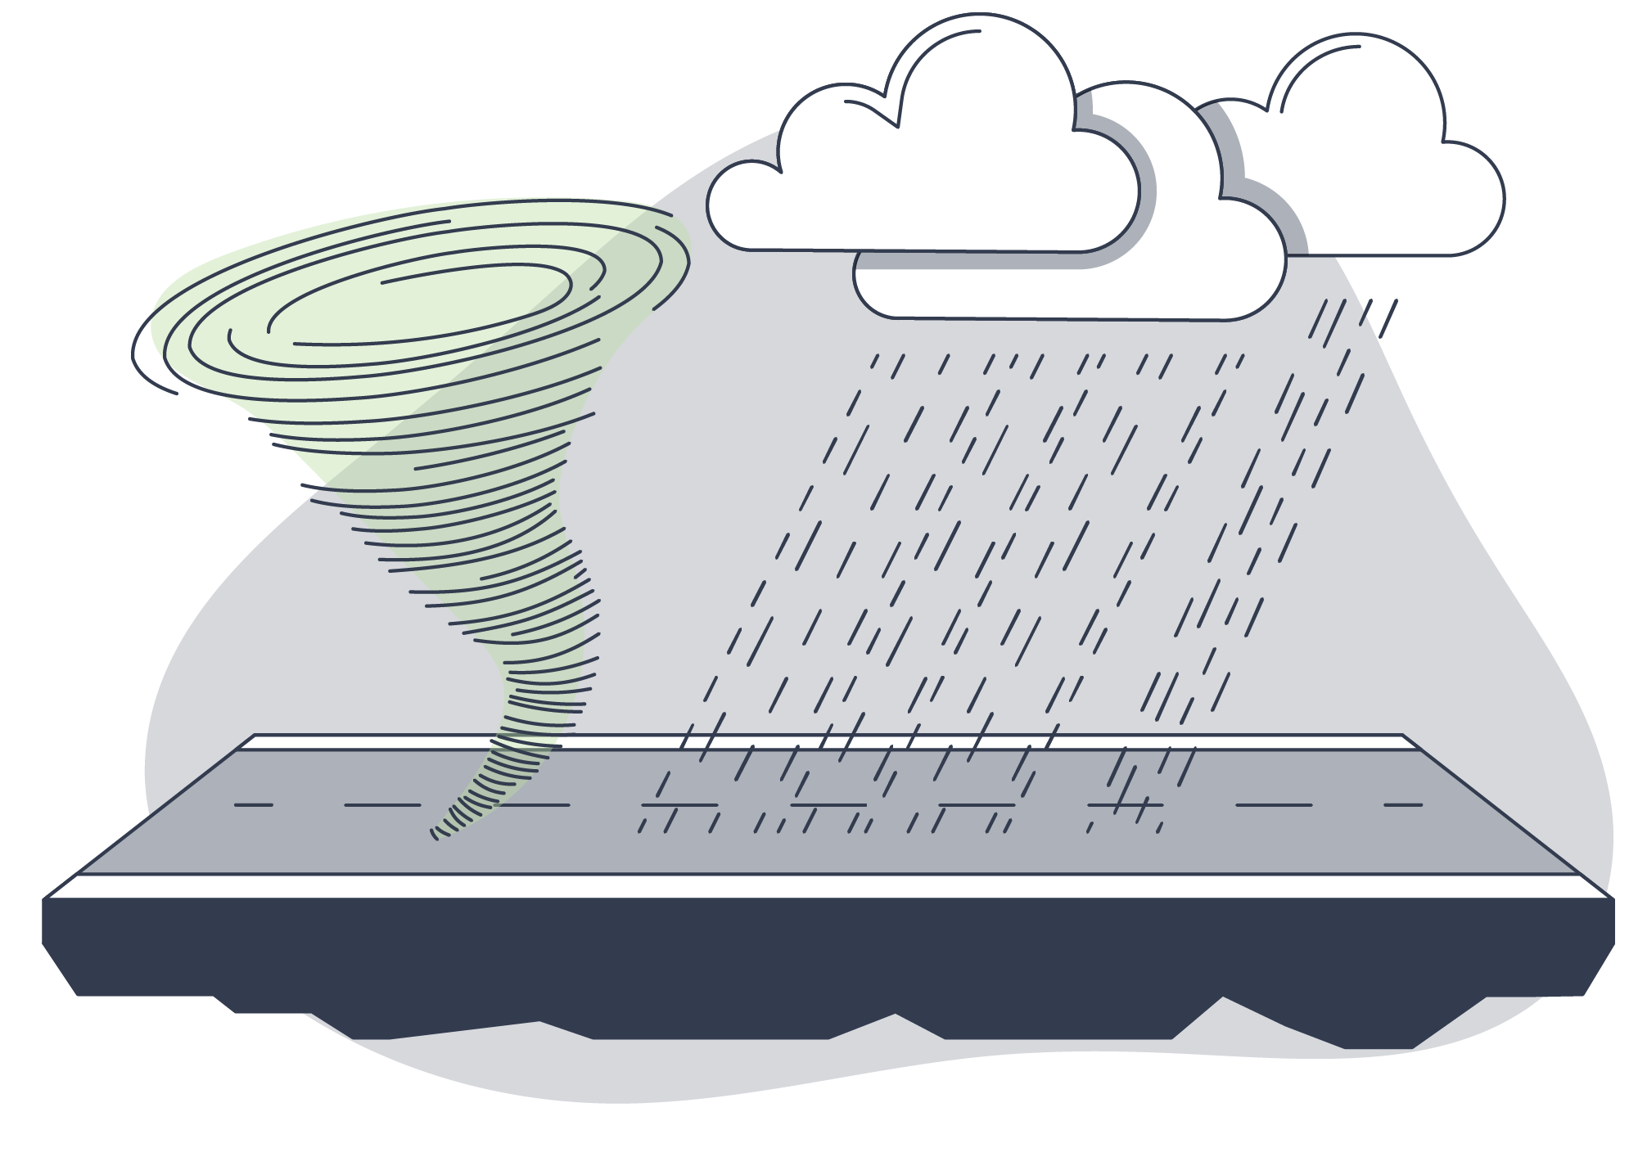
Environmental Resilience
Strengths
  Incorporation of re silie nce into AMPs
  Comple tion of Re silie nce Plans
  PROTECT funds
  Availability of inve ntorie s to support re imburse ment cla ims
We aknesses
  Political nature of the topic
  Availability of just-in-time training materia ls
  Vulne rability of funding
  Challe nges with inve sting in uncertain future s

Slide 12

Workforce & Knowledge Continuity
Strengths
  Some documentation of practice in place
  AMPs have he lped formalize and document e xisting processes
We aknesses
  Lack of innovative ways to speed up skill-building proce sses
  Availability of just-in-time training materia ls
  Vulne rability of funding
  Lack of e xpe rie nce with potential traps or vulne rabilitie s

Slide 13

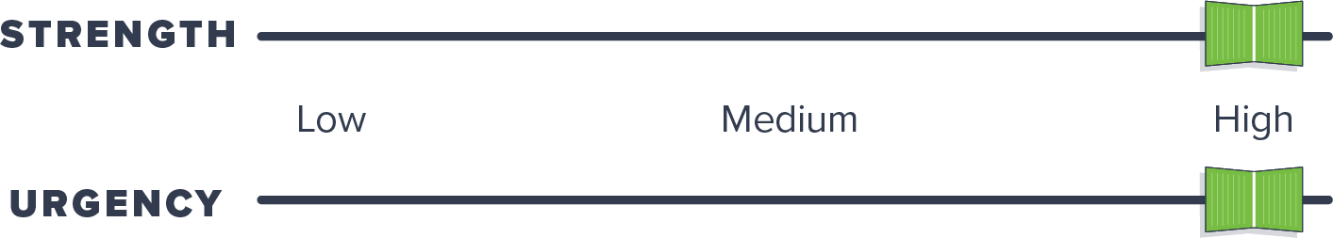
Agency Policy & Governance Alignment
Strengths
  Use of PBP to support asset management
  Use of asset management syste ms
  AMP require ments
  Adoption of asset management policie s in some agencie s
We aknesses
  Vulne rability to policy shifts
  Ine ffe ctive methods of
communicating long-te rm bene fits & thre ats from short-te rm strategie s
  Coordination with local NHS owners

Slide 14

Stakeholder Buy -In and Public Value
Strengths
  Some promotional materials on asset management bene fits
  Asset management principles are re latable to the public
We aknesses
  Lack of aware ness
  Inade quate funding due to underestimate d value
  Limite d ability to conside r broad needs in asset management
planning

Slide 15

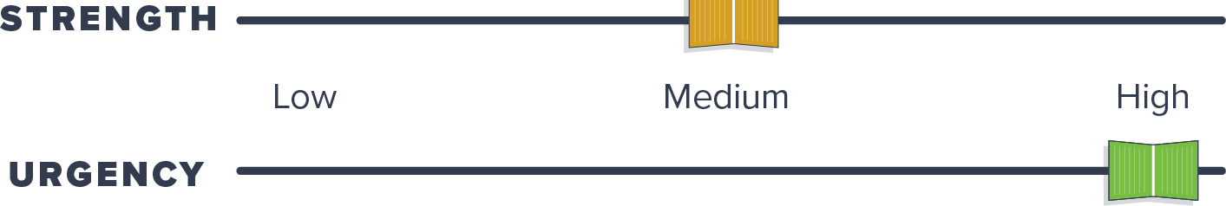
System Flexibility
Strengths
  Availability & use of management systems
  Initiative s to support local agency asset management
We aknesses
  Inability or hesitation to adapt mode ls
  System comple xity limits agility
  Few coordinate d e fforts to he lp local agencie s adopt asset
management

Slide 16




Top Priority Areas
Technological Adaptability
System Flexibility
Policy & Governance Alignment
Workforce & Knowledge Continuity

Slide 17

Next Steps
Invest in diverse talents & a dynamic culture

Slide 18

Next Steps
Invest in diverse talents & a dynamic culture
Be nimbler

Slide 19

Next Steps
Invest in diverse talents & a dynamic culture
Turn data into useful information
Be nimbler

Slide 20

Next Steps
Invest in diverse talents & a dynamic culture
Turn data into useful information
Be nimbler
Improve confidence in data & tools

Slide 21

Next Steps
Invest in diverse talents & a dynamic culture
Turn data into useful information
Take a chance
Be nimbler
Improve confidence in data & tools

Slide 22

Next Steps
Invest in diverse talents & a dynamic culture
Turn data into useful information
Take a chance
Be nimbler
Improve confidence in data & tools
Communicate asset management’s value

Slide 23


Slide 24
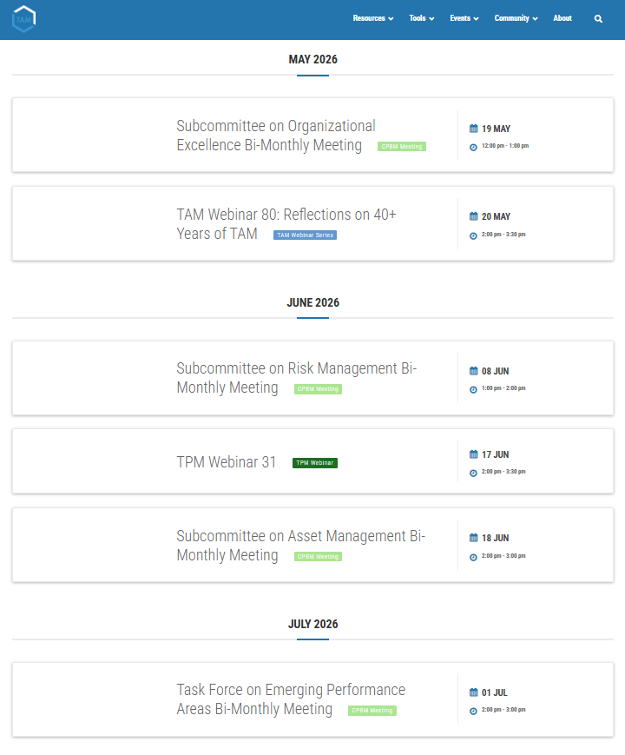
Save the Date!
To learn more about the Subcommittee on Asset Management, access the series archive, and explore asset management resources, visit the TAM Portal: https://www.tam-portal.com/
Join us for an upcoming webinar and subcommittee meeting!
  TAM Webinar 81
    July 15th, 2026: Organization, Leadership, and Culture Change
  TAM Webinar 82
    September 16th, 2026: Risk and Resilience in Asset Management
Thank you!!
24

